Slide 1

Vicon 101
Roar Lab Summer Seminar Series

Slide 2
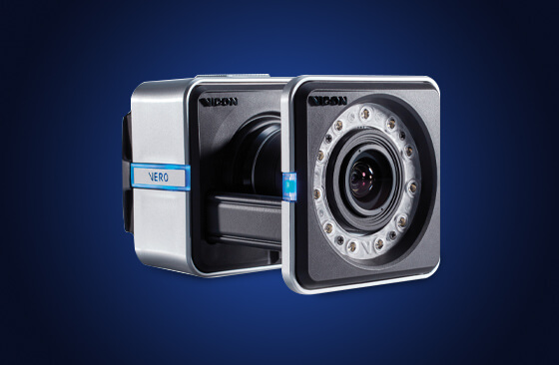
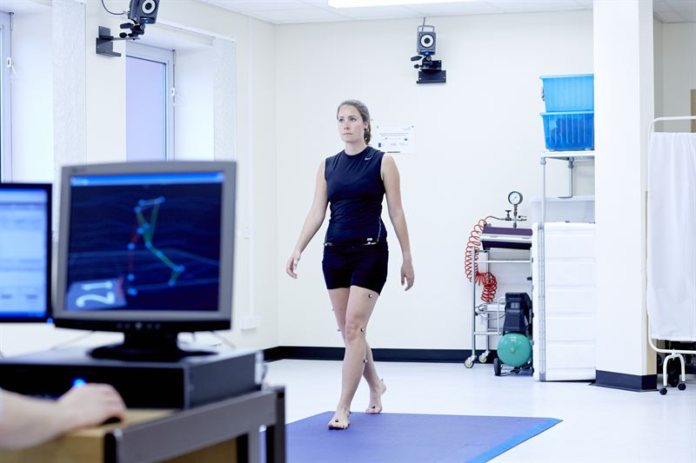

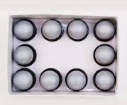
What is Vicon?
- An expensive motion capture system!
- The golden standard in motion capture precision and accuracy
Notes:
These cameras use infrared sensors to detect these markers

Slide 3


Vicon Nexus Software
- There’s always a version update
Notes:
This is what we use to collect our motion capture data in our experiments – and to post process the data – and then usually we export the raw data and then use either matlab or python to really process it

Slide 4
What will we cover today?
Creating a skeleton
Labeling
Auto labeling
Gap Filling
Common Issues and Solutions
Exporting

Slide 5
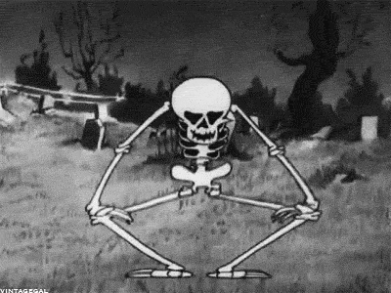
Creating a Skeleton
Notes:
You shouldn’t have multiple subjects within a trail – it can get messy

Slide 6
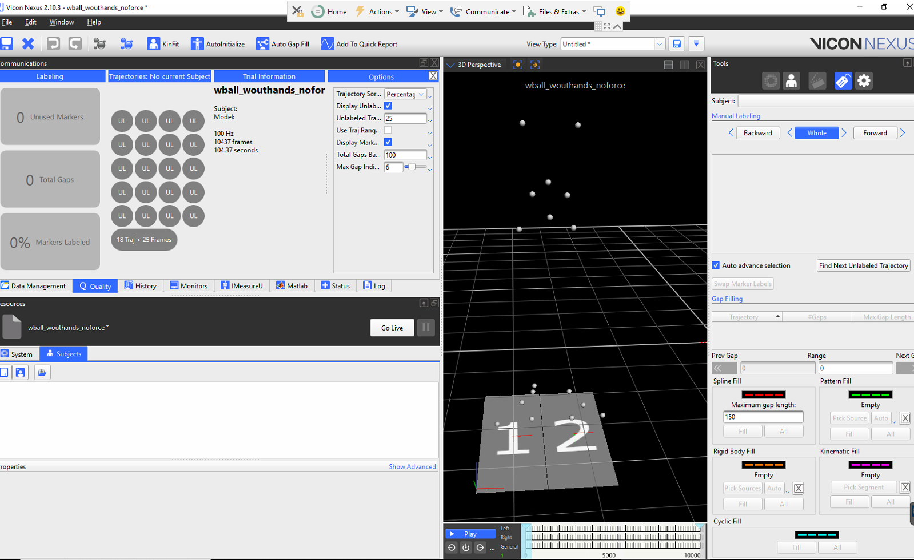
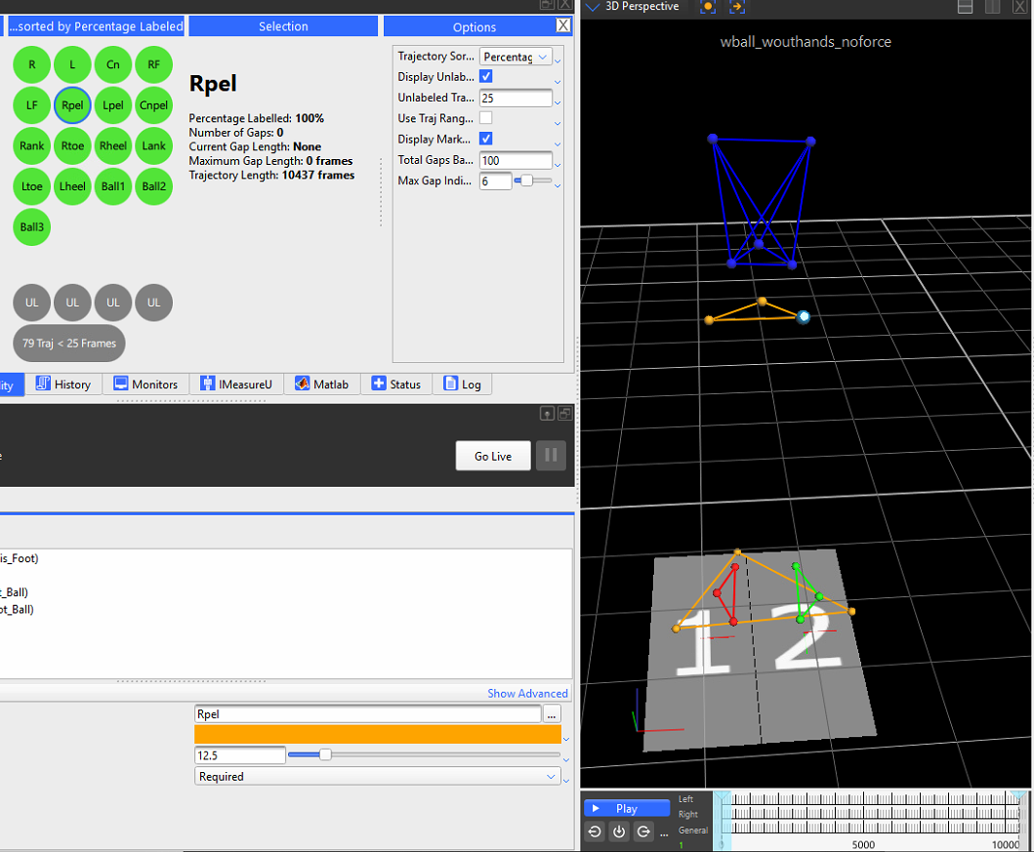
Notes:
Create a blank subject
Sub04
Click on sub icon
Labeling template builder: create segments

Slide 7

Labeling
Calibrate your cameras each time before your experiment!
Notes:
Exit and redo using the templete I just used

Slide 8
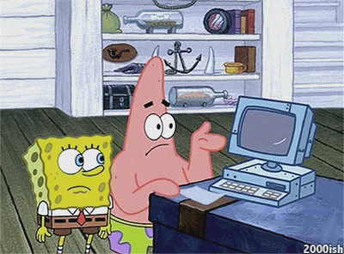
Labeling Part 2
Star_pre ns

Slide 9
Auto Labeling
Notes:
You can do part 1 to show what it should look like
Use part 2 unlabeled
Lable- use cpdyndelete
Static skeleton calibration
If markers missing you can select ignore calibration markers
Update skeleton parameters!
You can do the above if you have a baseline recording that way when you go to a new recording and click “reconstruct and label” it will perform better
And then try auto gap fill (this doesn’t always work depending on your trail)

Slide 10
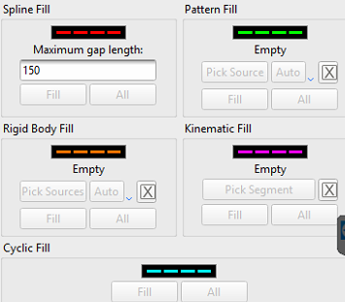
Labeling Gap Filling
Turn on Data correction view under Window > options
Spline Fill
Good for small gaps!
Pattern Fill
Uses another marker to fill out the missing marker
Use this for rigid bodies
Rigid Body Fill
You need four markers on that segment in order to use
Kinematic Fill
In order to use you need to run kinfill pipeline – it uses the kinematics to fill in the marker missing
Woltring
Spline - max should be 5% of your recording frequency
Notes:
The green line in pattern source is the other marker
https://www.youtube.com/watch?v=Km9ZKkDfVXg

Slide 11
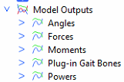
Model Outputs
-Use Vicon skeleton models – example plugingait LowerBody Ai
They have lower body, full body, upper body etc
https://docs.vicon.com/display/Nexus27/Lower+body+modeling+with+Plug-in+Gait
-You must fill in the subject parameters to get the model outputs
Body mass
Height
etc
Notes:
Show rands – plugingait lowerbody ai
Must fill in subject parameters –
Run > process dynamic plug in gait model

Slide 12
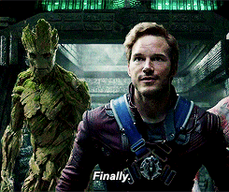
Exporting
Notes:
https://docs.vicon.com/display/Nexus210/Configure+file+export+pipeline+operations
Show them the pipelines – so they can automate things
I recommend making a pipeline once you understand a little better each step manually

Slide 13

Pipelines
Automates everything we went over!

Slide 14

Processing the Data

Slide 15

Resources
Vicon has great customer resources and you can always call them if you need support!
- YouTube channel has a lot of informative videos:
https://www.youtube.com/channel/UCMJ8Y90iMhuBUlTb09LhAFw
- Plug in Gait models and templates reference guide:
https://docs.vicon.com/display/Nexus27/Plug-in+Gait+models+and+templates
- Their newest user guide:
https://docs.vicon.com/display/Nexus210/Vicon+Nexus+User+Guide

